Slide 1



Company Overview of Microsoft Corporation
Author: Al Noman Robin
Created with Pi

Slide 2

CONTENTS
1. Introduction
2. Mission, Vision, and Objectives
3. Products and Services
4. Customer Segmentation & Target Market
5. Marketing & Branding Strategy
6. Innovation Strategy & SWOT Analysis
7. Thank You

Slide 3

01
Introduction

Slide 4


Overview
1
Founded in 1975 by Bill Gates and Paul Allen.
2
Headquartered in Redmond, Washington, USA.
3
Microsoft is a global technology company known for software, hardware, and services.

Slide 5

Key Departments
HR
IT
Finance
R&D
Marketing
Sales
Cloud & AI

Slide 6

02
Mission, Vision, and Objectives

Slide 7

Mission
To empower every person and organization on the planet to achieve more.

Slide 8

Vision
To help people and businesses realize their full potential.

Slide 9

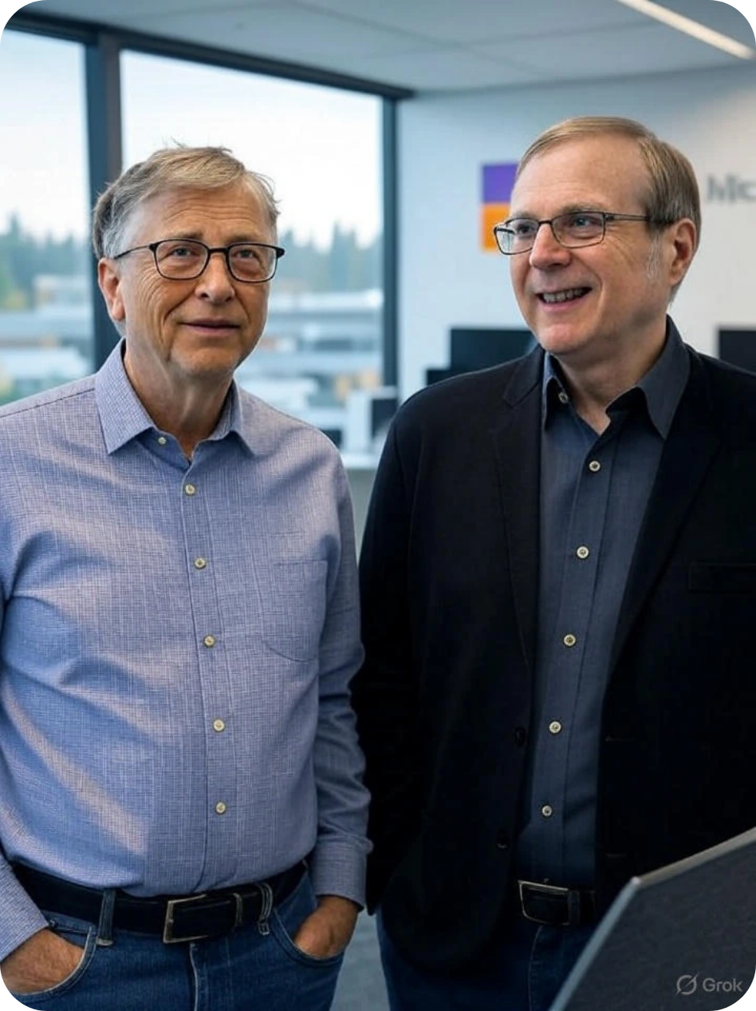
Objectives
Lead in cloud computing, AI integration, and productivity software.

Slide 10

03
Products and Services

Slide 11


Products and Services
Product-oriented
• Windows OS
• Microsoft Office
• Surface devices
• Xbox
Service-oriented
• Microsoft Azure
• Office 365
• LinkedIn
• GitHub
• Cloud and enterprise services are major revenue drivers.
• Combines software, cloud, and hardware to offer integrated experiences.

Slide 12

04
Customer Segmentation & Target Market

Slide 13


Demographics
Businesses
Developers
Students
Gamers
Enterprises

Slide 14



Psychographics
Tech users
Productivity seekers
Cloud developers

Slide 15

Target Market
Global businesses and individuals across industries.

Slide 16

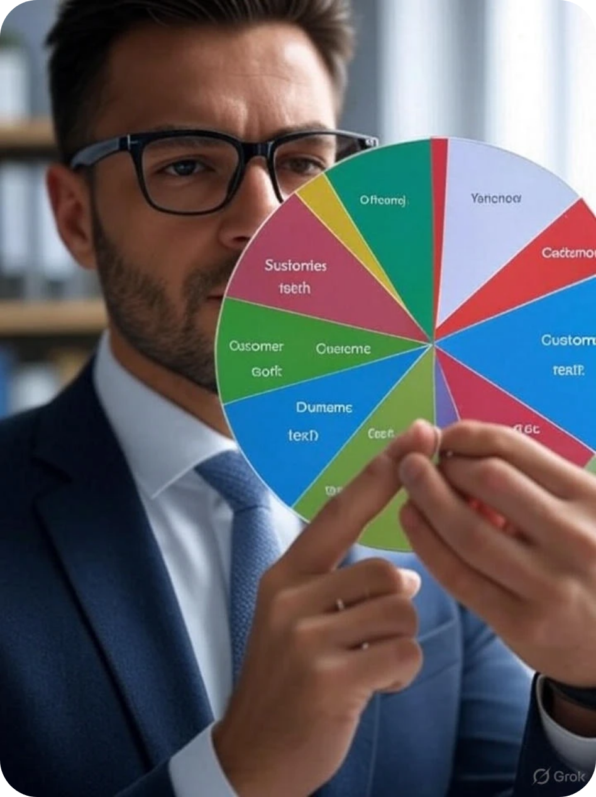
Channels
Online stores
Resellers
Enterprise contracts
Education sector

Slide 17

05
Marketing & Branding Strategy

Slide 18




Marketing & Branding Strategy
Value Proposition
Branding
Marketing Channels
Brand Slogans
• Reliable, innovative software and cloud services.
• Known for productivity, trust, and enterprise-grade tools.
• 'Empowering us all', 'Be what's next'.
• Digital ads, global partnerships, tech events, demos.

Slide 19

06
Innovation Strategy & SWOT Analysis

Slide 20

Innovation
Heavy R&D in AI (Copilot), cloud (Azure), productivity tools.

Slide 21





SWOT Analysis
Strengths
Weaknesses
Dominant OS market share, cloud leadership, trusted brand.
Dependence on enterprise clients, some failed hardware (e.g., Lumia).
Opportunities
Threats
Expand AI integration, gaming (Activision), hybrid work tech.
Competition from Google, Amazon, regulatory scrutiny.

Slide 22
07
Thank You

Slide 23




Thank You
Al Noman Robin
01774-139359
robinalnoman@gmail.com

Slide 24

Thank You

